Slide 1

BUILDING A CODE OPTIMIZER
FOR NOVEL PROGRAMMING LANGUAGE
Mukesh 192210498
Saikiran 192225109
Swagath 192210519

Slide 2

Introduction to Code Optimization
Code optimization is the process of improving the performance of code. This can involve making code run faster, use less memory, or both. Code optimization is a crucial aspect of software development, ensuring efficient and reliable applications.

Slide 3
Importance of Code Optimization
Optimized code leads to faster execution times, improving user experience and overall application performance. It also reduces resource consumption, leading to lower costs and a more sustainable approach.
1
Enhanced User Experience
2
Improved Scalability
Faster loading times and smoother application performance lead to greater user satisfaction and engagement.
Optimized code allows applications to handle larger workloads and user demands efficiently, ensuring long-term stability.
3
Reduced Development Costs
4
Increased Reliability
Efficient code minimizes resource usage, leading to lower infrastructure and maintenance expenses.
Optimized code is less prone to errors and crashes, enhancing application stability and reducing downtime.

Slide 4
Common Techniques for Code Optimization
Various techniques can be employed to optimize code. These include using efficient algorithms, data structures, and optimizing loops for speed and memory usage.
Algorithm Selection
Data Structure Optimization
Loop Optimization
Choosing efficient algorithms for specific tasks can significantly impact performance. For example, a sorting algorithm like merge sort offers better performance for large datasets compared to bubble sort.
Optimizing loops through techniques like loop unrolling or vectorization can improve execution speed by reducing the overhead associated with loop iterations.
Selecting appropriate data structures, such as hash tables for fast lookups or linked lists for dynamic memory allocation, can optimize code performance.

Slide 5

Identifying Performance Bottlenecks
Bottlenecks are areas in code that significantly impact performance. Identifying these areas is crucial for effective optimization.
1
Profiling
Profiling tools provide insights into code execution times and resource usage, helping pinpoint performance bottlenecks.
2
Code Review
Manual code review can uncover potential inefficiencies and areas for optimization, especially when combined with profiling results.
3
Benchmarking
Benchmarking involves comparing the performance of different code versions or algorithms to identify areas for improvement.

Slide 6
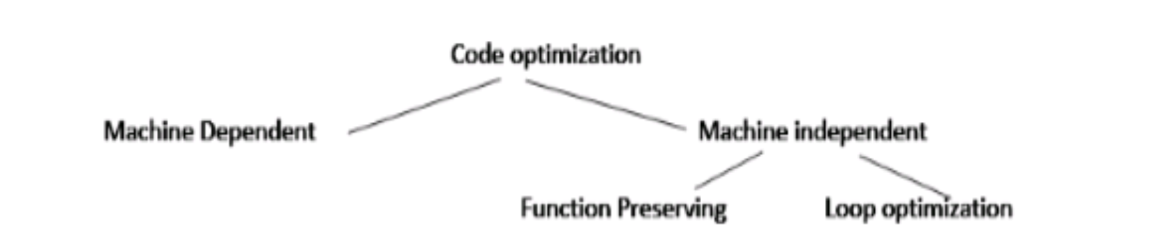
Optimizing Code for Memory Usage
Memory optimization focuses on reducing the amount of memory used by code, improving efficiency and preventing memory leaks.
Data Structure Choice
Memory Management
Code Reuse
Using data structures that minimize memory overhead, such as arrays for contiguous data storage or linked lists for dynamic memory allocation, can reduce memory consumption.
Proper memory management practices, including allocating and deallocating memory efficiently, are essential to prevent memory leaks and ensure optimal memory usage.
Reusing existing code segments and libraries reduces memory consumption by avoiding redundant code duplication.

Slide 7
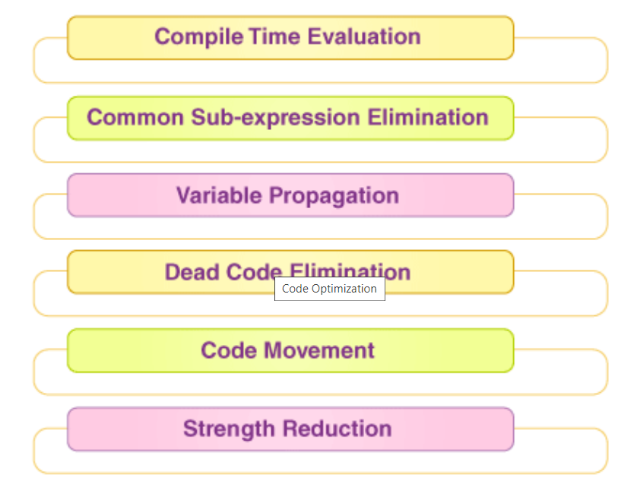



Optimizing Code for Execution Speed
Execution speed optimization aims to reduce the time it takes for code to run, improving overall application performance.
Algorithm Selection
Choosing efficient algorithms can significantly improve execution speed. For example, a binary search algorithm is much faster than a linear search for large datasets.
Loop Optimization
Optimizing loops through techniques like loop unrolling or vectorization can reduce the overhead associated with loop iterations, speeding up execution.
Code Inlining
Inlining functions can improve execution speed by eliminating function call overhead, especially for small functions called frequently.

Slide 8
Best Practices for Code Optimization
Following best practices can contribute to efficient and well-optimized code. These practices involve using appropriate techniques and tools to achieve optimal performance.
Measure Before Optimizing
Profile your code to identify actual performance bottlenecks before applying any optimization techniques.
Focus on Critical Areas
Prioritize optimization efforts on areas of the code that have the most significant impact on performance.
Use Profiling Tools
Leverage profiling tools to identify performance bottlenecks and assess the effectiveness of optimization techniques.
Code Readability
Maintain code readability and maintainability, even when optimizing. Well-structured code is easier to understand and maintain.
Test Thoroughly
Thoroughly test your code after each optimization step to ensure that the changes haven't introduced any unintended consequences.

Slide 9




Conclusion and Key Takeaways
Code optimization is an essential aspect of software development, contributing to improved performance, user experience, and cost efficiency. By applying the right techniques and following best practices, developers can significantly enhance the performance and reliability of their applications.
Speed Matters
Memory Efficiency
Maintainability
Best Practices
Optimized code leads to faster execution times, improving user experience and overall application performance.
Efficient memory usage minimizes resource consumption, leading to lower costs and a more sustainable approach.
Well-optimized code is easier to understand and maintain, reducing long-term development costs and enhancing application stability.
Following best practices ensures that optimization efforts are effective and sustainable, leading to high-quality and performant applications.

Slide 10
THANK YOU

